Slide 1
Neighbourhood Plan Update November 2019

Slide 2
Site surveys
Sites surveyed:
SON No.
1 Old Copse Field, off Woodlands Road
12a Blackmore Lane North (lower)
12b Blackmore Lane North (upper)
21a Blackmore Lane South
21b Land north of Reddish Manor, Peppard Road
22 Blounts Court Road
23 Johnson Matthey car park, Widmore Lane
24 Land behind Widmore Pond, Blounts Court Road
26 Rudgings Plantation, Kennylands Road
27 Alpen Rose, Kennylands Road
29 Reddish Manor, Peppard Road

Slide 3
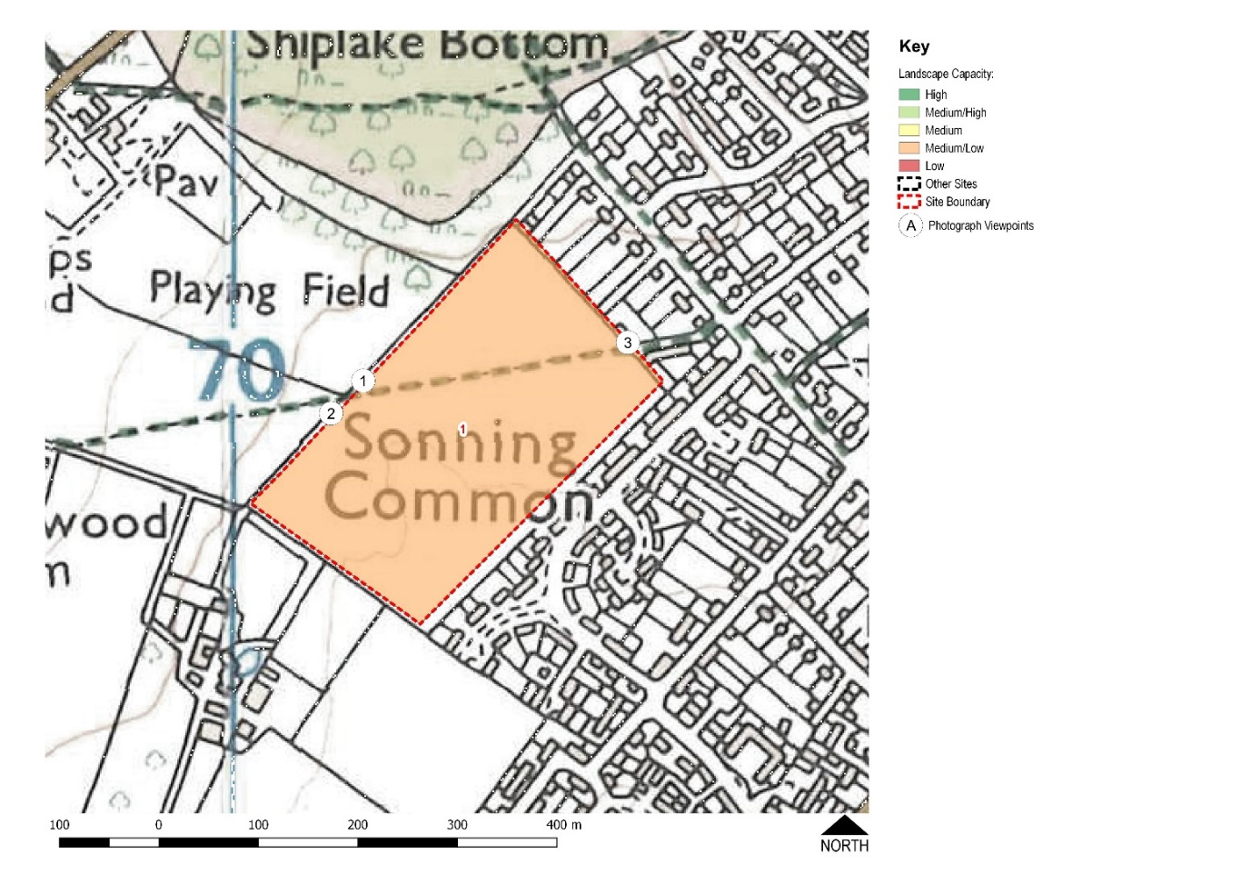
SON 1
Old Copse Field

Slide 4
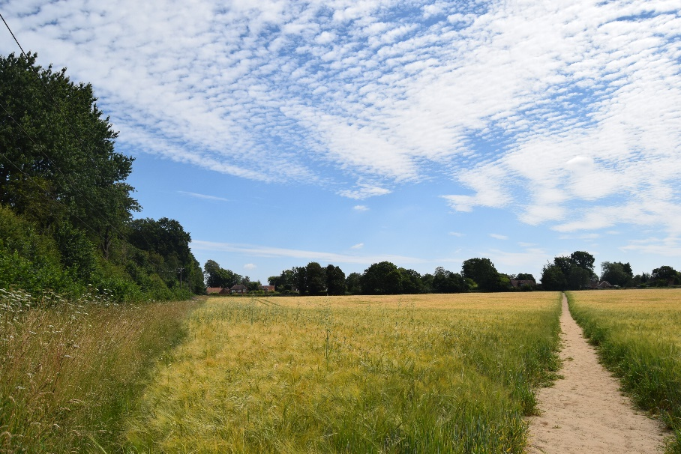
The 6.2 hectare SON 1 site abuts the rear gardens of Woodlands Road, Orchard Avenue and Lambourne Road.
Access is currently off Woodlands Road via a narrow path. There is no vehicle access from a public road.
It is currently agricultural land within the AONB and designated as Local Green Space (LGS) within the existing Neighbourhood Plan
View north-east from public footpath entering SON 1site from recreation ground.

Slide 5
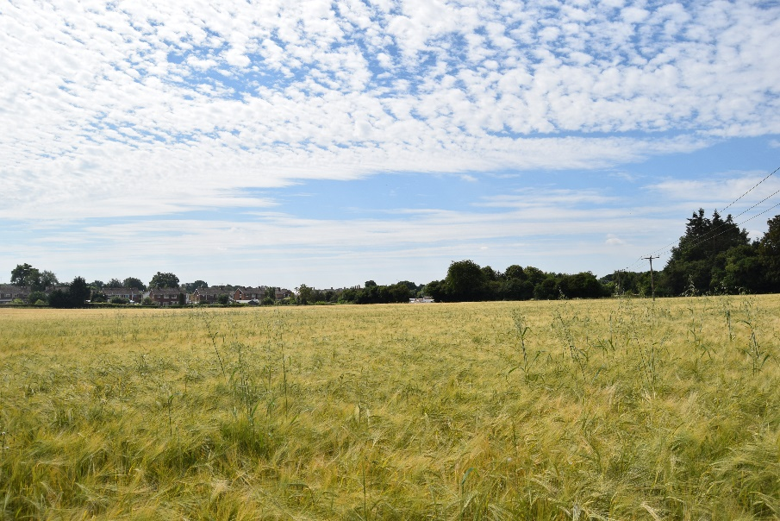
Open views of housing on south-eastern edge
SON 1 site is adjacent to the Old Copse ancient woodland, purchased by villagers and placed under the protection of the Woodlands Trust.
The well-used footpath links Woodlands Road with the Rotherfield United Football Club playing fields and Sonning Common skate park.

Slide 6
SON 1 Evaluation criteria:
Traffic light scoring:
Fairly even distribution between red, amber and green
Consultant’s comments:
This site is not recommended for further consideration as a potential site option for the following reasons:
Development on this site could harm to views from the wider AONB to the west
It would harm the setting of the Public Right of Way
It would result in the loss of a valued Local Green Space
It would harm the landscape and visual setting of the AONB
The only existing access to the site is along the route of the Public Right of Way through the north east boundary

Slide 7
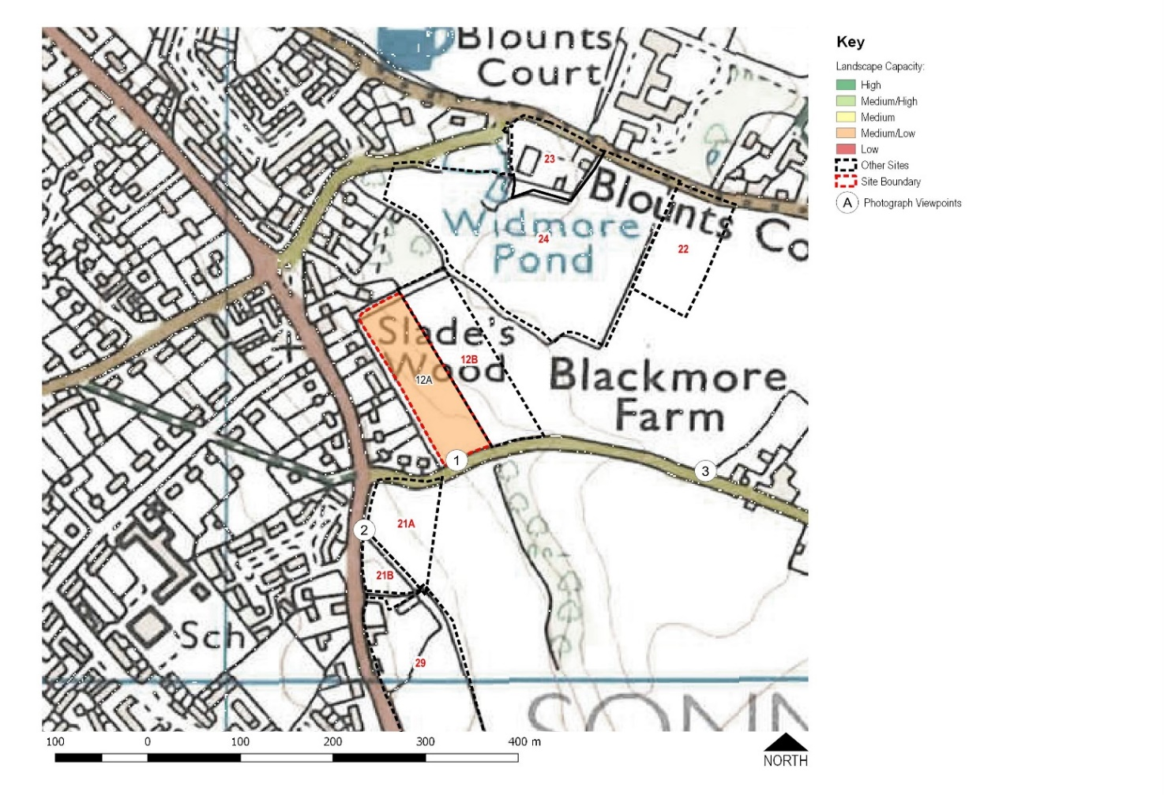
SON 12a
Blackmore Lane North (lower)

Slide 8
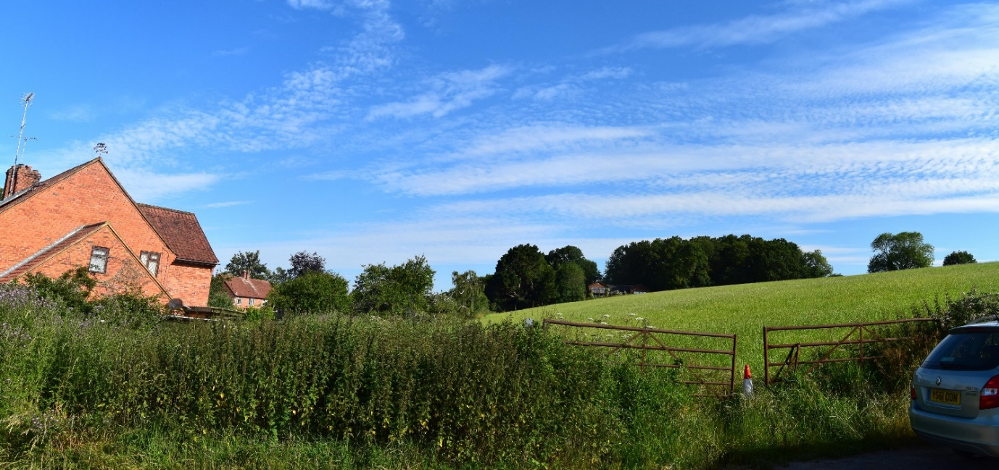
The 0.9 hectare SON 12a site is located alongside Blackmore Lane
Access is from Blackmore Lane
It is currently grade 3 agricultural land in the AONB

Slide 9
SON 12a Evaluation criteria:
Traffic light scoring:
Most scores were red, followed by amber.
Consultant’s comments:
Recommended that SON 12a is not considered further as a potential site for development due to the following constraints:
Negative effect on the settlement pattern
The site’s location within the AONB
The generally rural and tranquil nature of the setting

Slide 10
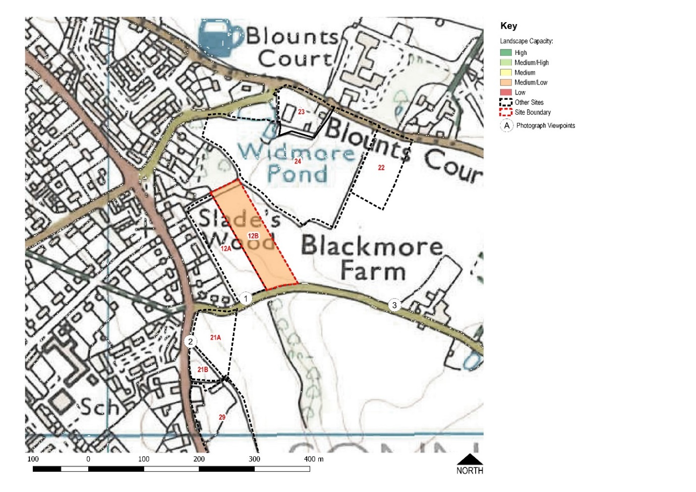
SON 12b
Blackmore Lane North (upper)

Slide 11
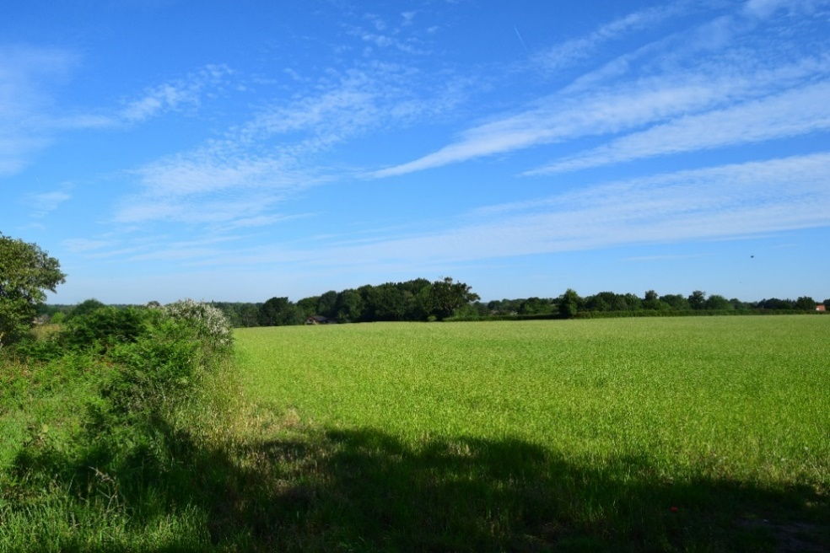
The SON 12b site is 1.3 hectares
Access would be from Blackmore Lane, probably via SON 12a
It is currently Grade 3 agricultural land
It is in the AONB

Slide 12
SON 12b Evaluation criteria:
Traffic light scoring:
The surveyors gave this site red and scores.
Consultant’s comments:
Recommended that SON 12b is not considered further as a potential site option due to the following constraints:
Negative effect on the settlement pattern
The site’s location within the AONB and potential harm to special qualities
The generally rural and tranquil nature of the setting
Blackmore Lane, the only possible means of access, is very narrow and classed as a ‘Failed Road’.

Slide 13
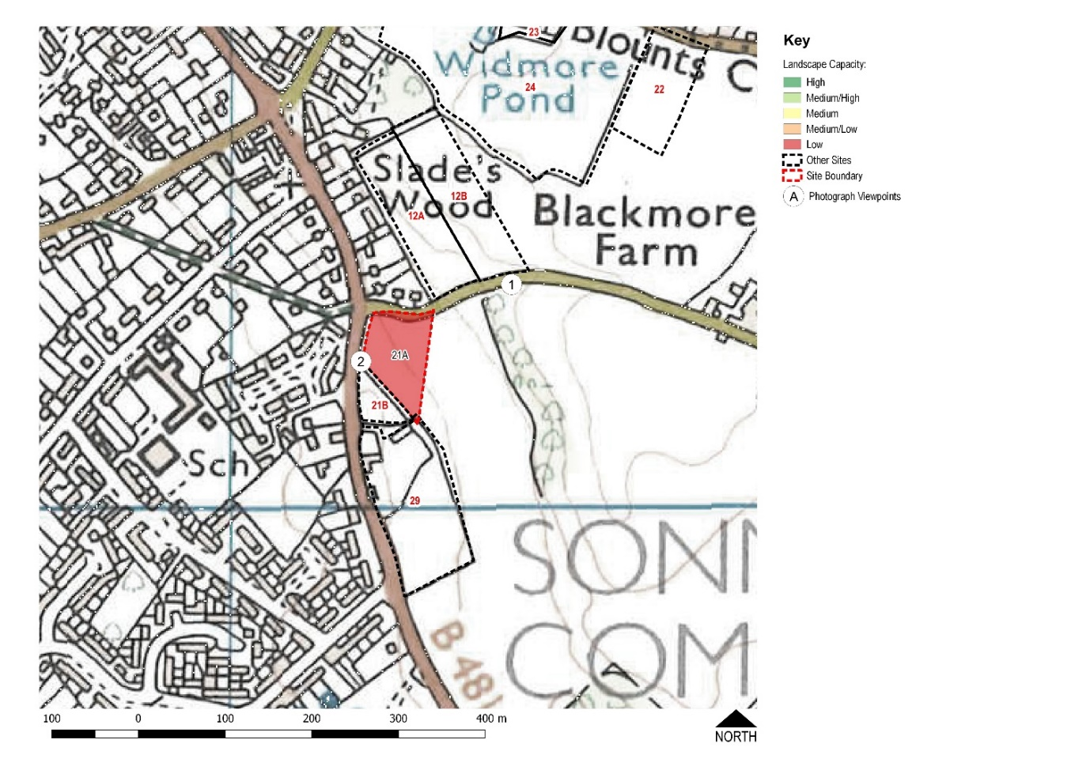
SON 21a
Blackmore Lane South

Slide 14
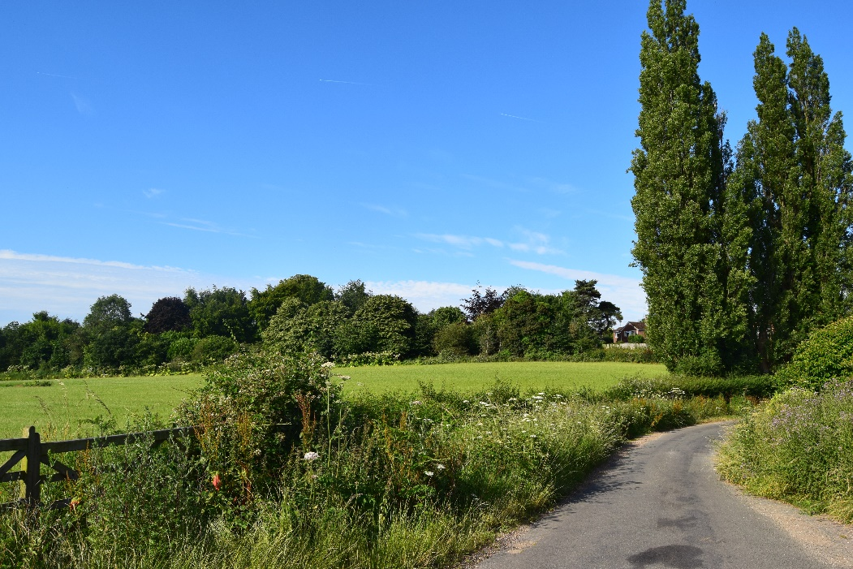
The SON 21a site is 0.7 hectares
Access is from Blackmore Lane or Peppard Road
Site in agricultural use and classified as Grade 3 agricultural land
In the AONB.

Slide 15
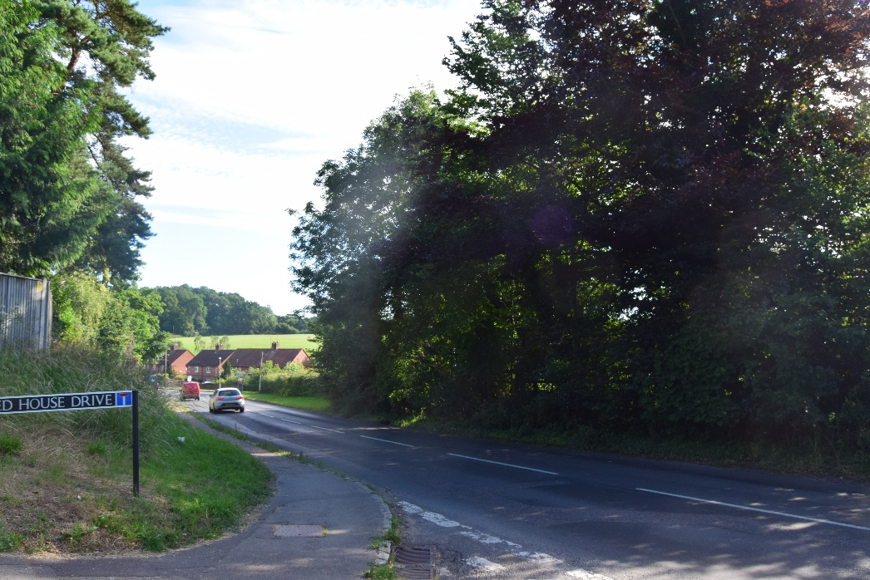
SON 21a site’s boundary is visible from Peppard Road (hedge to right of road, centre of photo)

Slide 16
SON 21a Evaluation criteria
Traffic light scoring:
Most of the survey ratings were amber
Consultant’s comments:
Recommended that SON 21a is not considered further as a potential site for development due to the following constraints:
The negative effect on the settlement pattern and the strong countryside edge formed by Peppard Road
The visual prominence of the site
The site’s location within the AONB and potential harm to special qualities
The generally rural and tranquil nature of the setting
Notes:
The last LVIA comment is surprising considering that the site partially on the Peppard Road

Slide 17
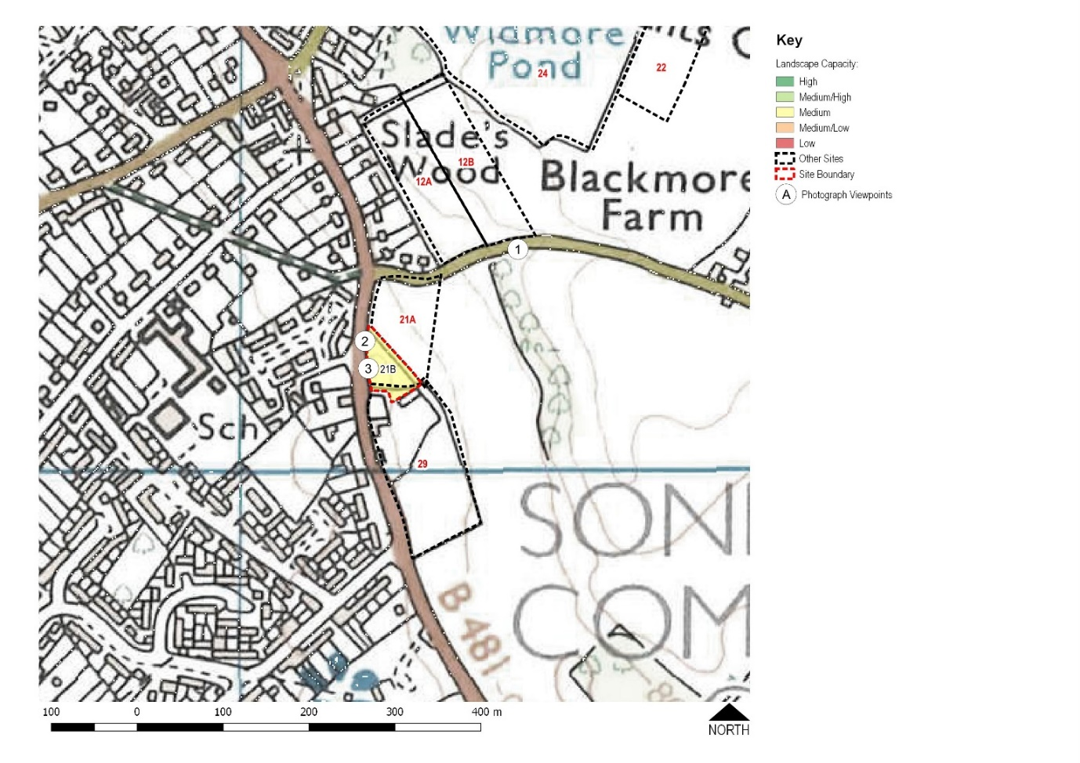
SON 21b
Land north of Reddish Manor

Slide 18
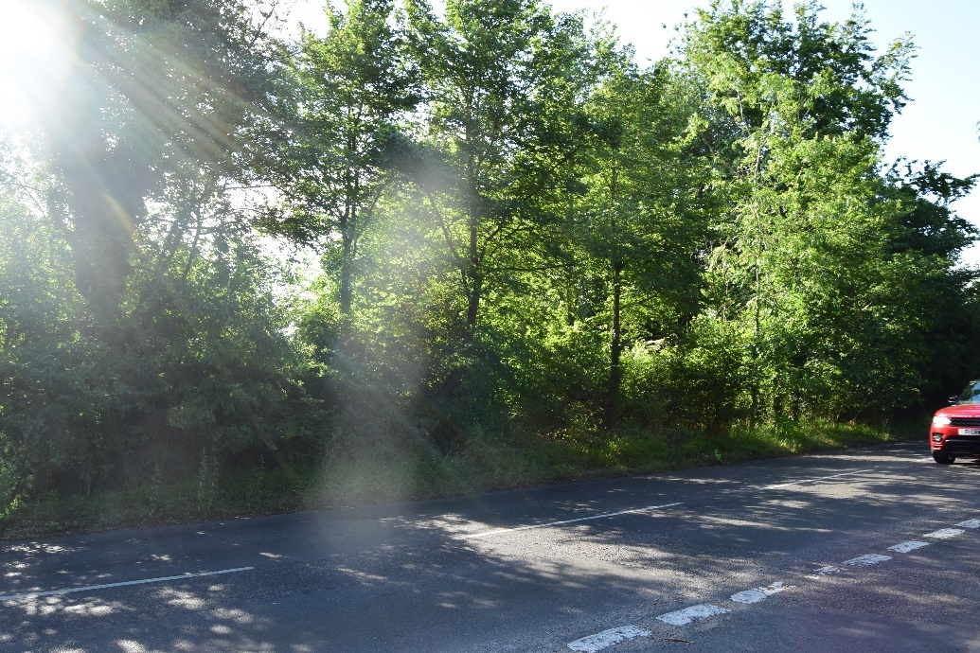
Trees along site’s boundary are visible from Peppard Road
The SON 21b site is 0.3 hectares
Access is from Peppard Road, B481
Undeveloped site, not currently in use
Not in AONB

Slide 19
SON 21b Evaluation criteria:
Traffic light scoring:
Generally amber or green
Some concern over access for pedestrians and vehicles
Consultant’s comments:
The capacity of SON 21b is constrained by:
The negative effect on the settlement pattern through the intensification of housing on the eastern side of Peppard Road
The visual prominence of the site’s external trees
The site’s location adjacent to the AONB
Should only be considered for very limited development

Slide 20
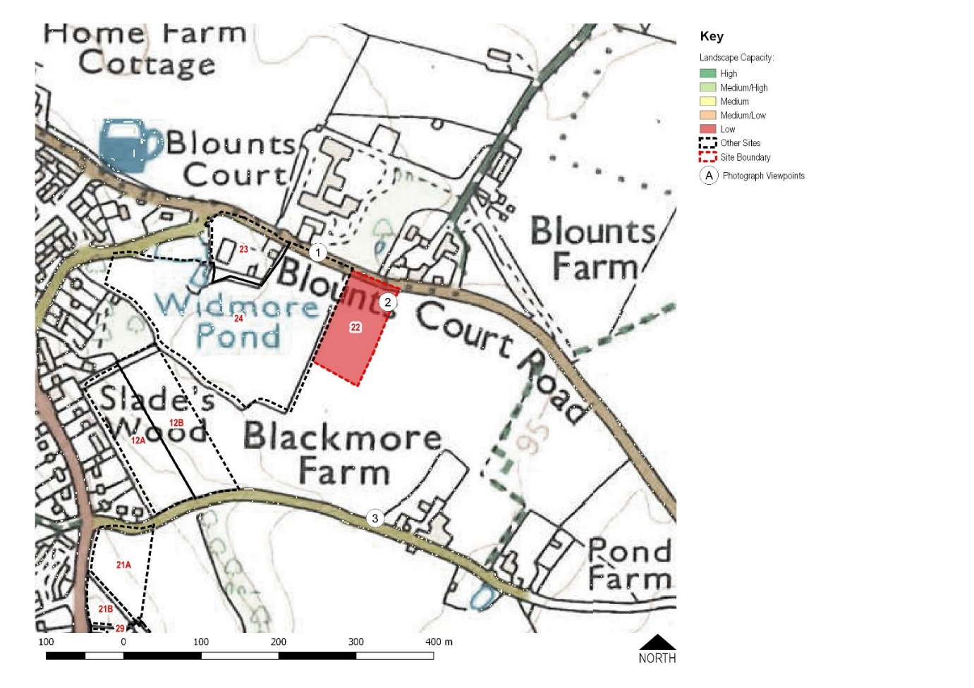
SON 22
Blounts Court Road

Slide 21
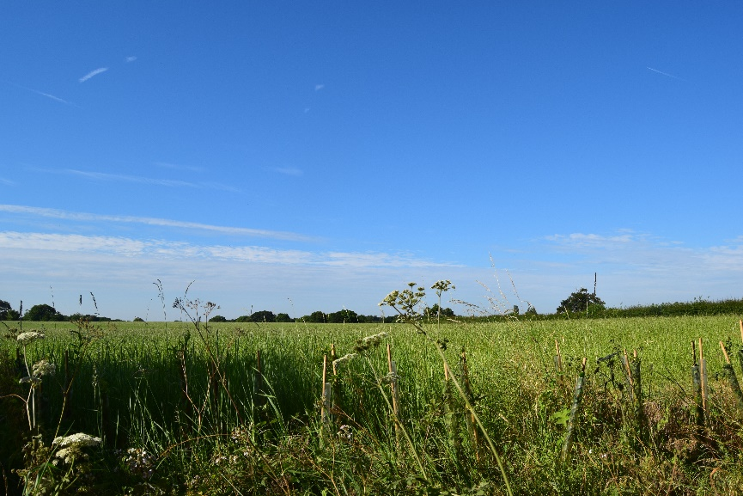
The SON 22 site is 0.9 hectares
Access is from Blounts Court Road
It is currently in agricultural use and classified as Grade 3 agricultural land
It is in the AONB

Slide 22
SON 22 Evaluation criteria:
Traffic light scoring:
The site received a majority of red scores
Consultant’s comments:
Recommended that SON 22 is not considered further as a potential site option due to the following constraints:
The site’s separation from the settlement and importance as part of the rural approach to the village
Strong relationship with the wider countryside – development on the site would encroach into the wider landscape
Location within the AONB and potential harm to special qualities
The strongly rural and tranquil nature of the site

Slide 23
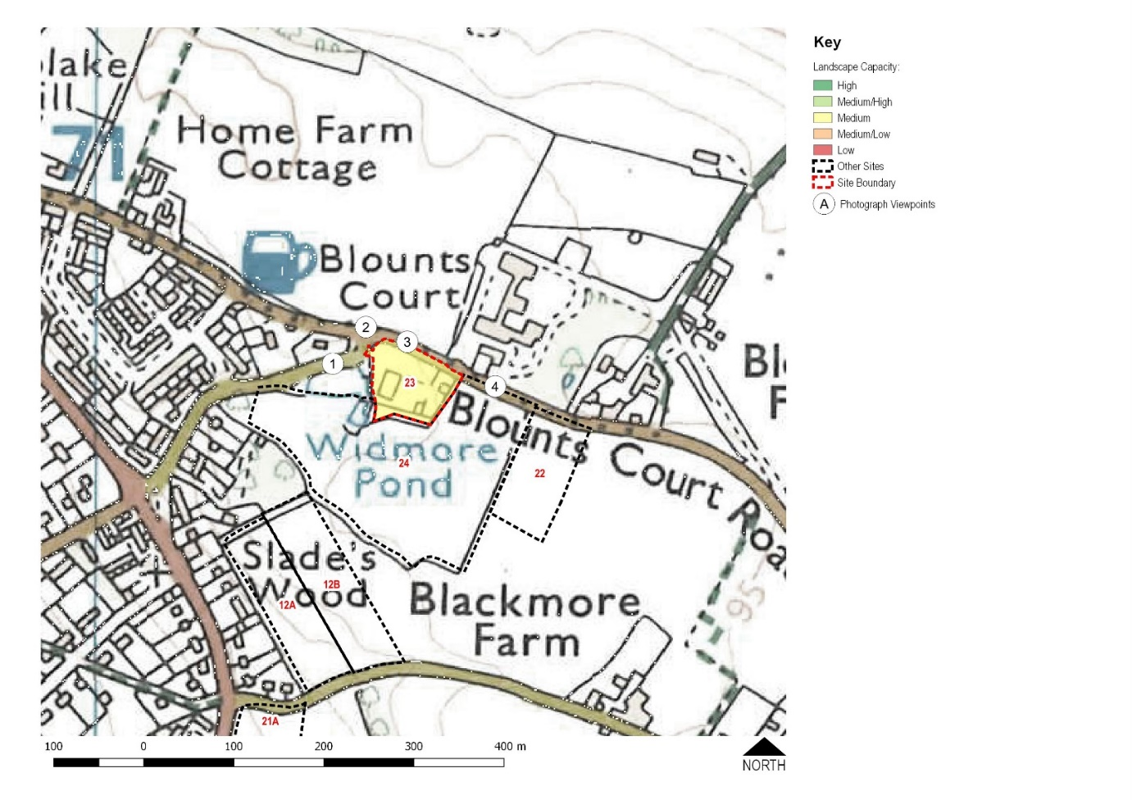
SON 23
Johnson Matthey car park

Slide 24
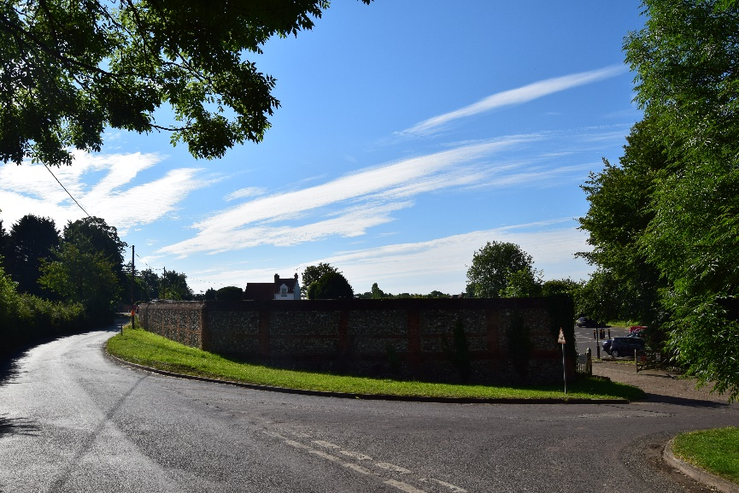
The SON 23 site is 0.7 hectares
Access is from Widmore Lane
Currently used as a car park by the staff of Johnson Matthey
It is in the AONB

Slide 25
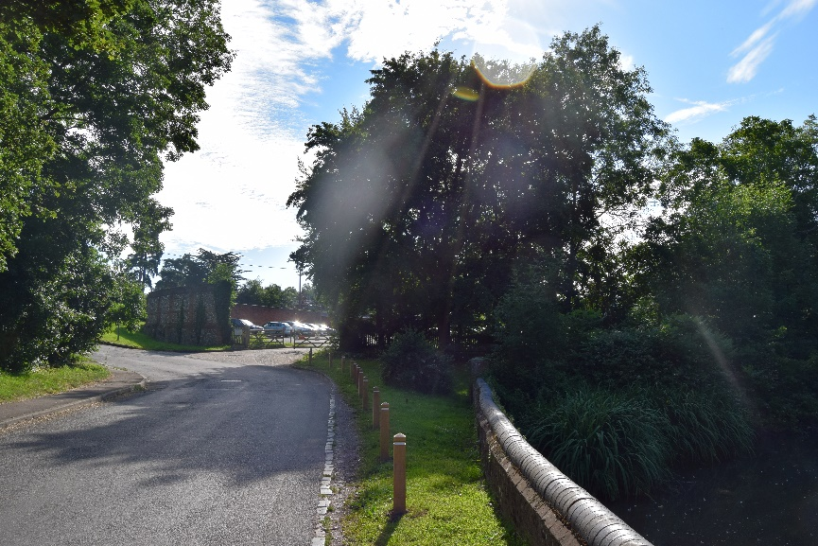
View of SON 23 site entrance from Widmore Lane

Slide 26
SON 23 Evaluation criteria:
Traffic lights scoring:
Almost entirely green but with some concerns about the narrow roads and traffic.
Consultant’s comments:
The capacity of SON 23 is constrained by:
The site’s location within the AONB
The visual prominence of the site from adjacent roads
However, with a medium capacity, SON 23 could be considered as a potential site for further development.

Slide 27
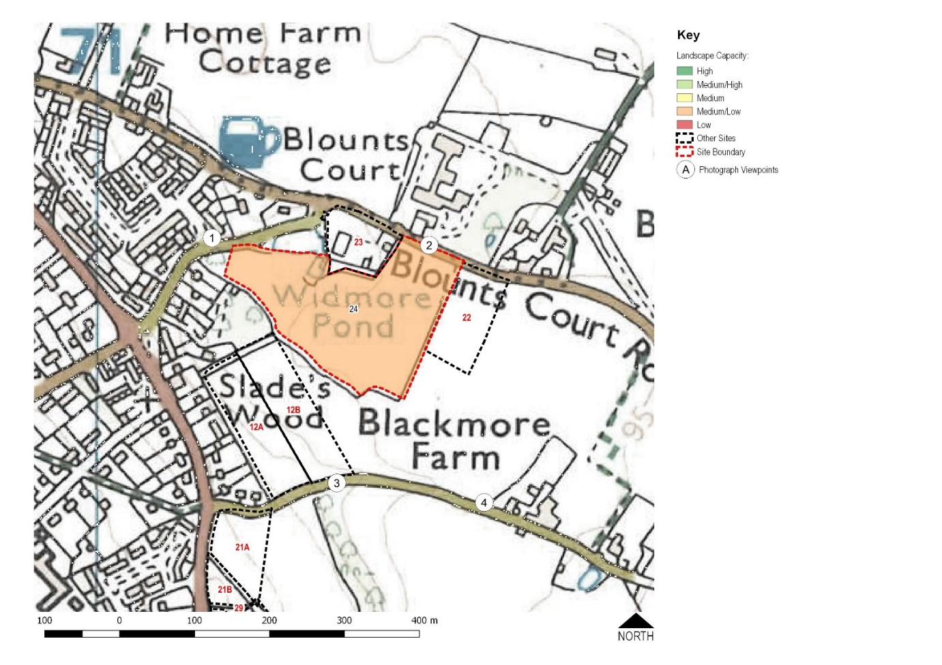
SON 24
Land behind Widmore Pond

Slide 28
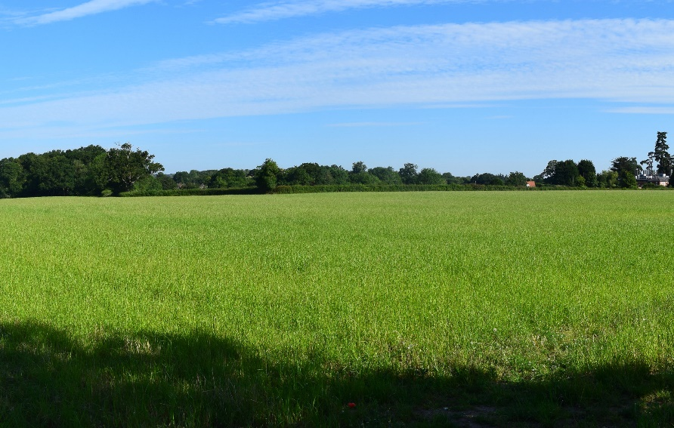
The SON 24 site is visible across fields from Blackmore lane
The SON 24 site is 3.4 hectares
Access is from Blounts Court Road
It is currently in agricultural use and is grade 3 agricultural land
It is in the AONB.

Slide 29
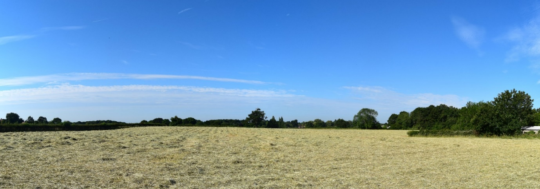
SON 24 site viewed from Blounts Court Road.

Slide 30
SON 24 Evaluation criteria:
Traffic light scoring:
The majority of the scoring is amber and is followed by red with relatively few green.
Consultant’s comments:
Recommend that SON 24 is not considered further as a potential housing site due to the following constraints:
The site’s location is within the AONB and the potential harm to special qualities
The visibility of the eastern parts of site from views within the AONB
The importance of mature trees along the western boundaries
The remoteness of the eastern parts of site from the settlement and the role that part of site plays in the rural approach to the village

Slide 31
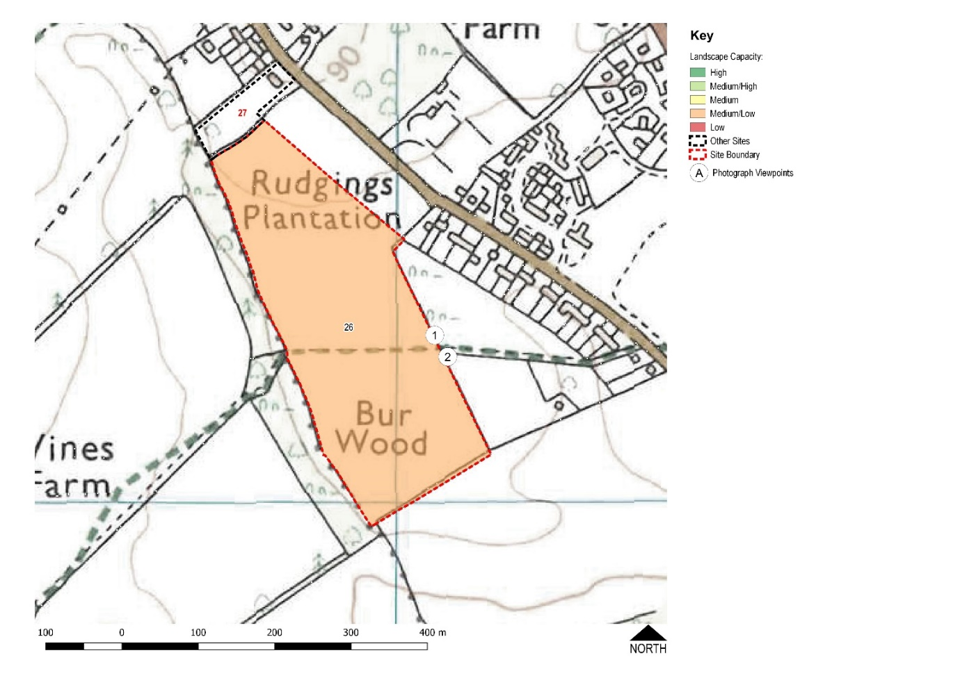
SON 26
Rudgings Plantation

Slide 32
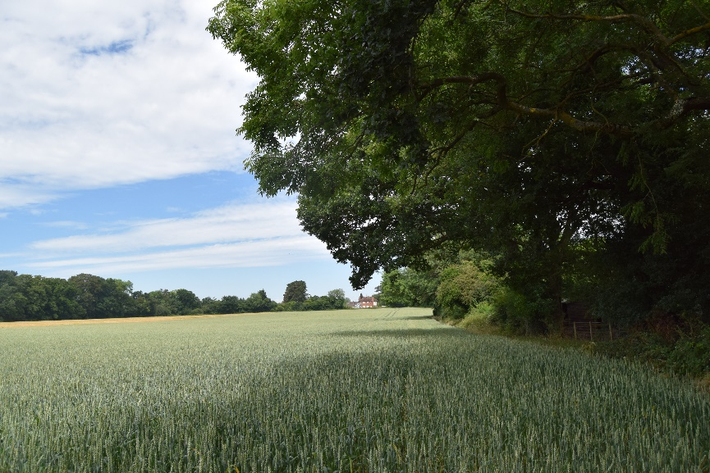
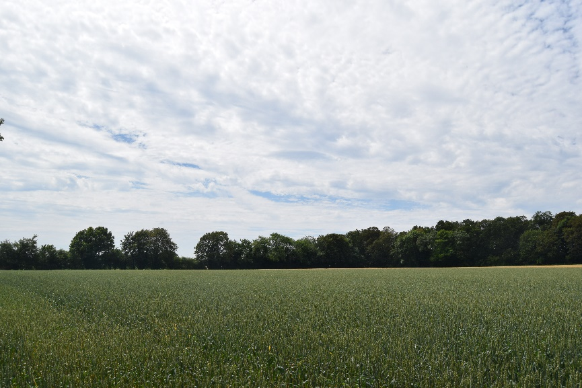

Slide 33
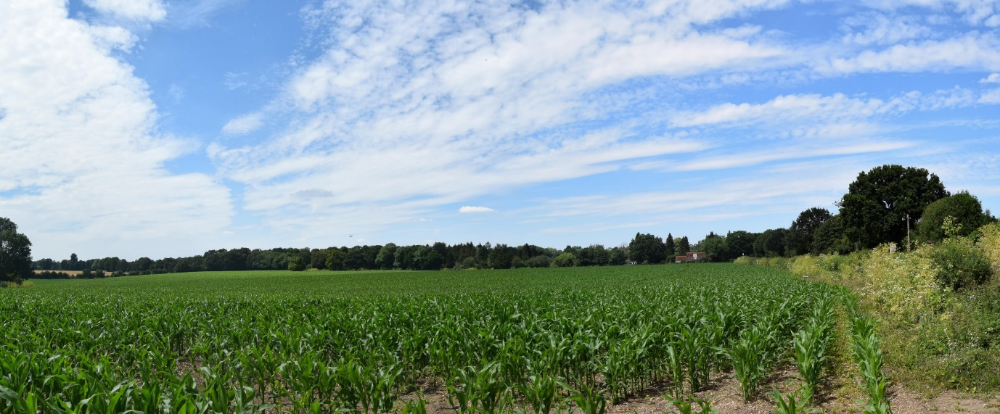
The area of the SON 26 site is 6.7 hectares
Access would be from Kennylands Road
Current use is agricultural and the land is agricultural grade 3.
It is not in the AONB
A previous application for development on part of the site was rejected by HM Inspector on appeal

Slide 34
SON 26 Evaluation criteria:
Traffic light scoring:
The scores are again very balanced with amber slightly ahead followed by red.
Consultant’s comments:
Recommended that SON 26 is not considered further as a potential site for future development due to the following constraints:
Impacts on open views from, and the rural setting of, the public footpath which crosses the site
The site’s location within the setting of the AONB and potential harm to special qualities
The site’s separation from the settlement and importance as part of the rural setting of the village and strong relationship with the wider countryside
Development of even a small part of this site would result in the loss of the pattern of narrow, linear settlement south-west of Kennylands Road
The strongly rural and tranquil nature of the site.

Slide 35
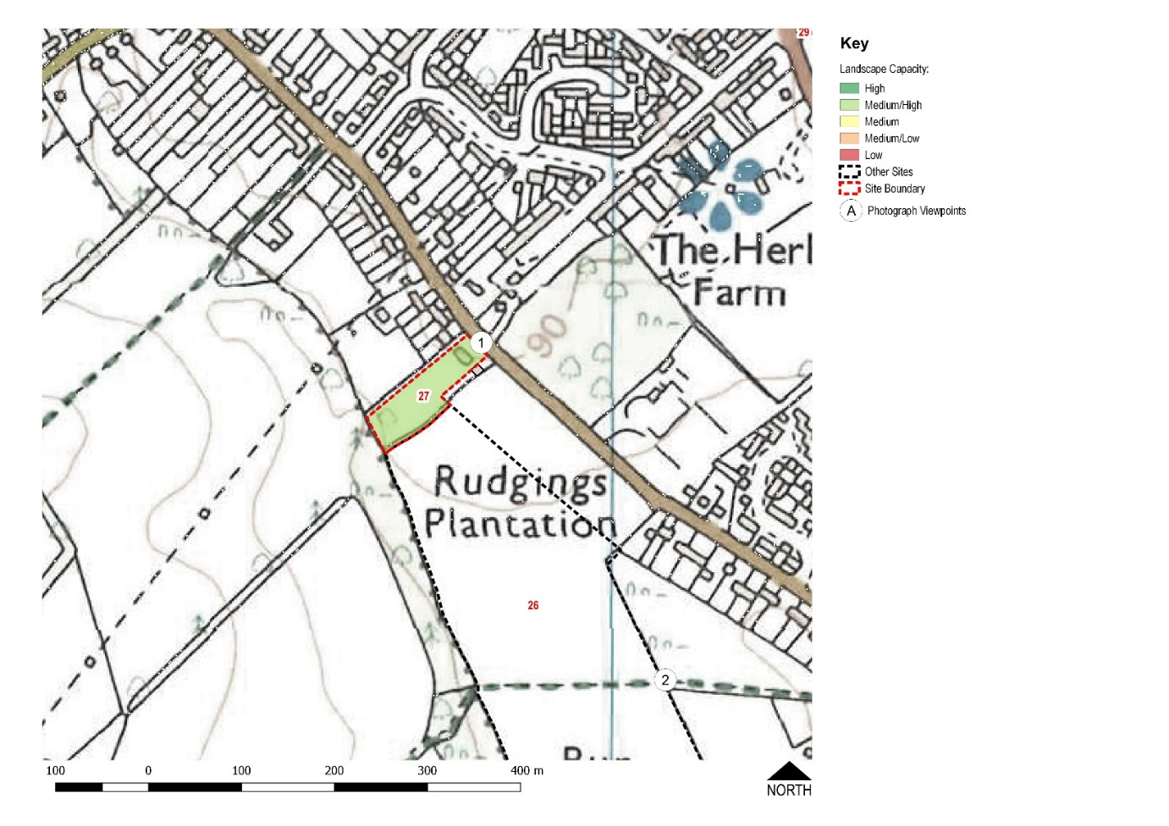
SON 27
Alpen Rose

Slide 36
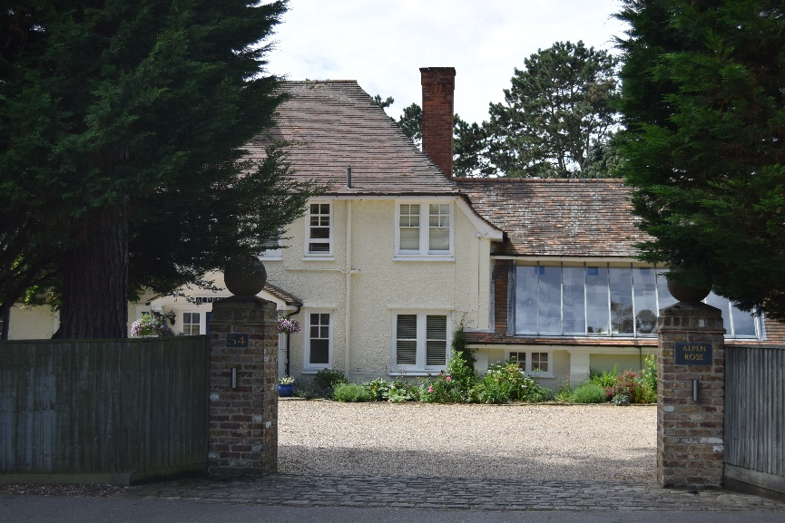
SON 27 Alpen Rose, Kennylands Road

Slide 37
The SON 27 site is 0.6 hectares
Access is from Kennylands Road
It is not in the AONB
It is currently a private house and garden with an orchard at the rear
There are TPOs in force for the mature trees in the garden

Slide 38
SON 27 Evaluation criteria:
Traffic light scoring:
The majority of the scores were green.
Consultant’s comments:
The capacity of SON 27 is constrained by:
The site’s location within the setting of the AONB and potential harm to special qualities
Potential effects on the linear settlement pattern in this part of the village
However, with a medium / high capacity, SON 27 could be considered further as a potential site for future development.

Slide 39
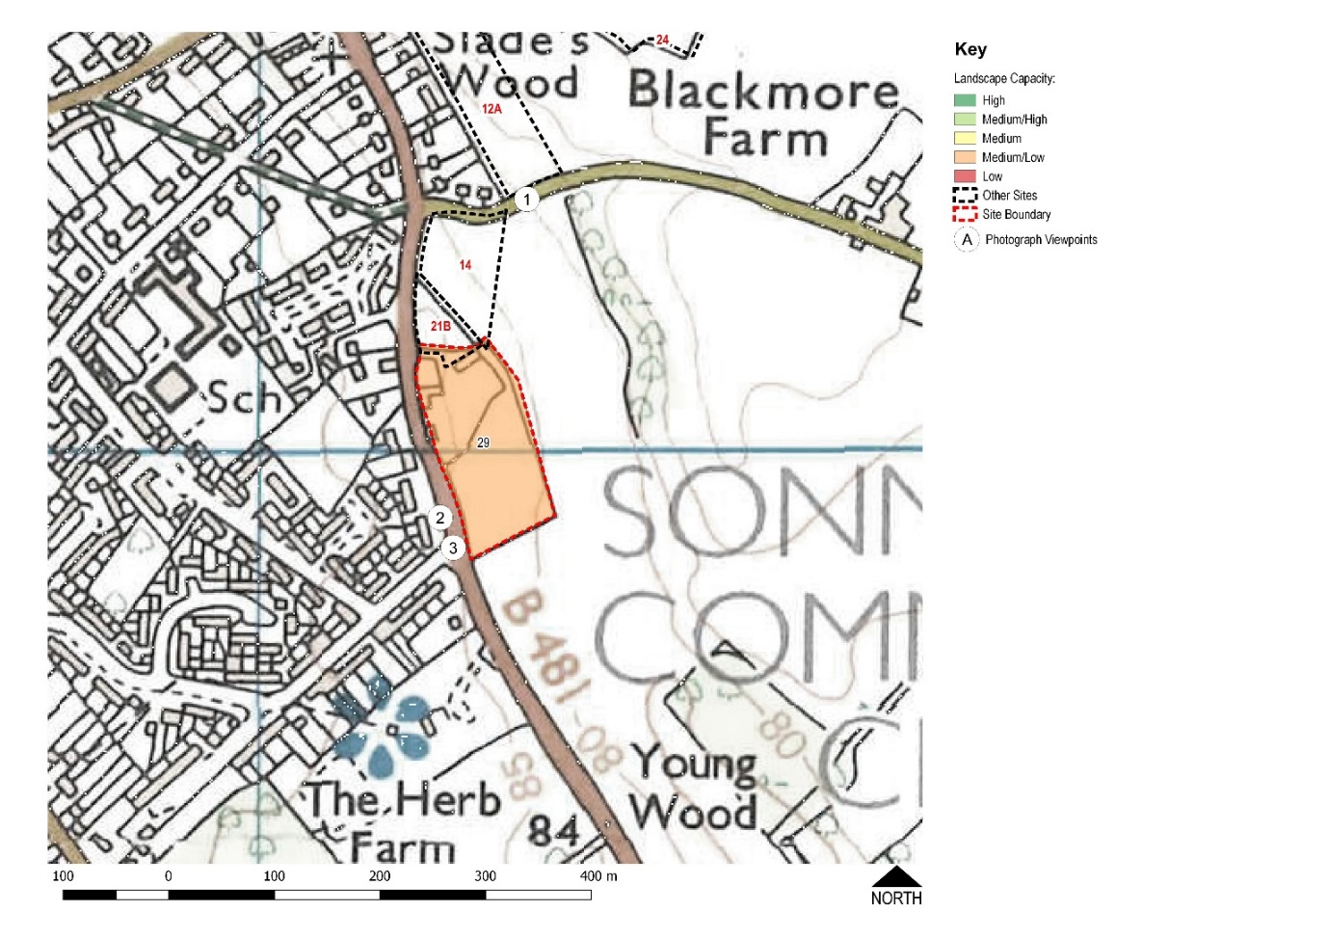
SON 29
Reddish Manor

Slide 40
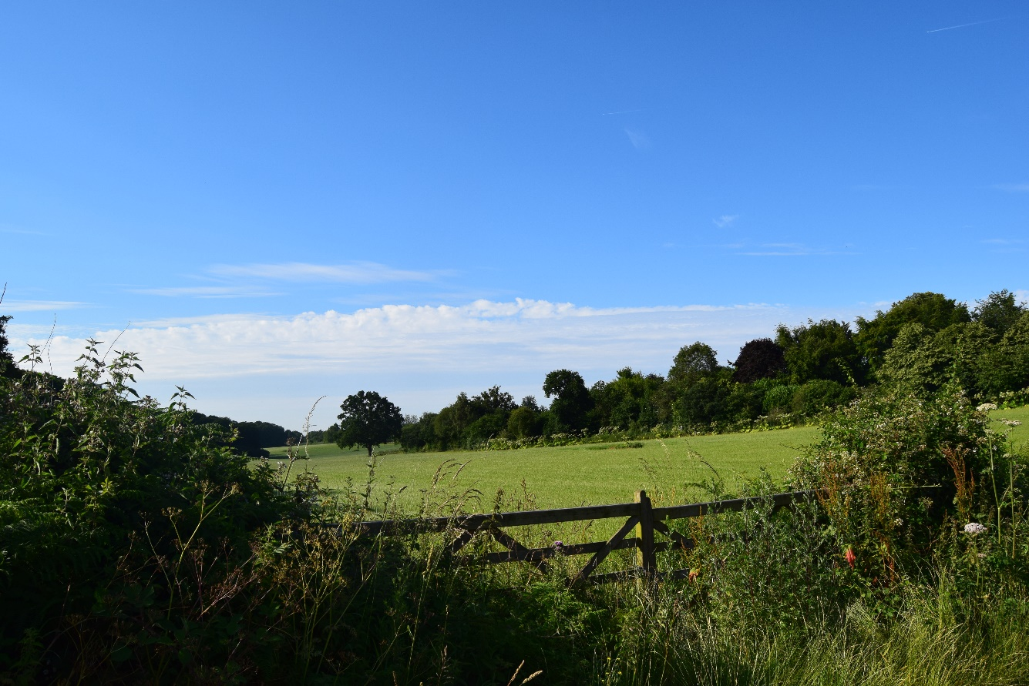
Trees on and surrounding the SON 29 site are visible from Blackmore Lane
The SON 29 site is 1.5 hectares
Access is from Peppard Road (B481)
It is part garden and part paddock
The paddock is in the AONB

Slide 41
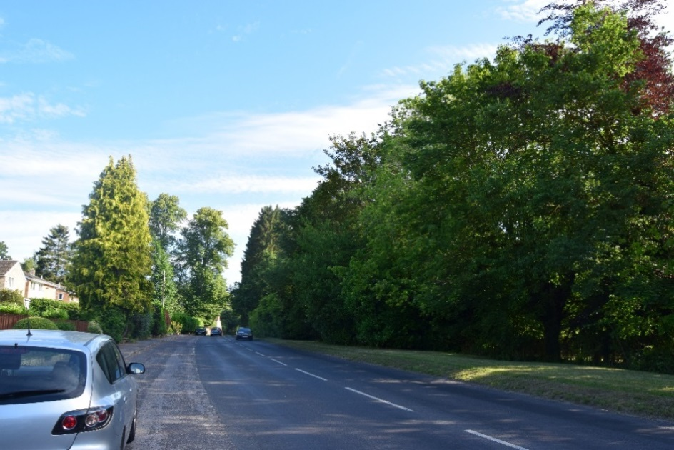
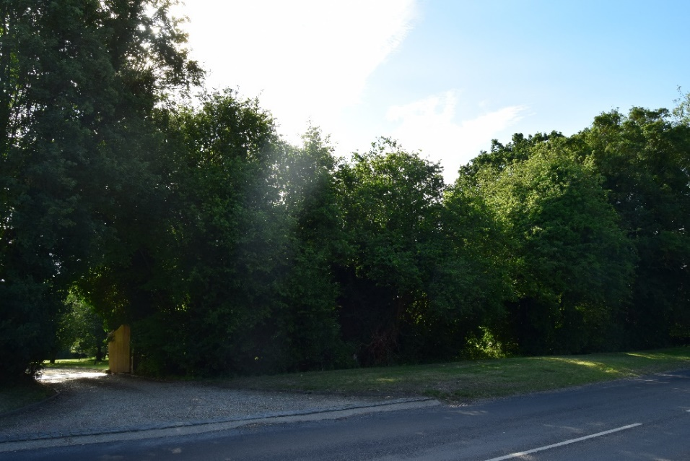
SON 29

Slide 42
SON 29 Evaluation criteria:
Traffic light scoring:
The traffic lights show a mixture of red, amber and green in similar proportions.
Consultant’s comments:
The capacity of SON 29 is constrained by:
The negative effect on the settlement pattern through the intensification of housing on the eastern side of Peppard Road
The visual prominence of the site’s external trees
The site’s location within and adjacent to the AONB and potential harm to special qualities
However, given that the site is well contained by its boundary vegetation and already contains a house, a very limited amount of development could be accommodated in the northern part of the site. The southern part of the site should remain undeveloped to avoid harm to the AONB and sprawl of the settlement pattern.

